Slide 1

Prepared by Mohamed Wahban
Data analysis Project
Sales Data Analysis – Amazon.com Products

Slide 2
PROJECT OBJECTIVE & DATASET DESCRIPTION
In this analysis, we explored a dataset of over 2,000 sales transactions from Amazon.com, including detailed fields such as Region, Product, Sales Representative, COGS, Sales, Profit, and Date.
Using Pivot Tables and Excel Charts, we aimed to answer key business questions and extract valuable insights about performance across time, regions, and products.

Slide 3
Section 1 – Overall Performance
Q1: What is the total sales amount per year?
Q2: What is the total profit per year?
Q3: What is the average monthly profit?
Q4: What is the total sales amount per region?

Slide 4
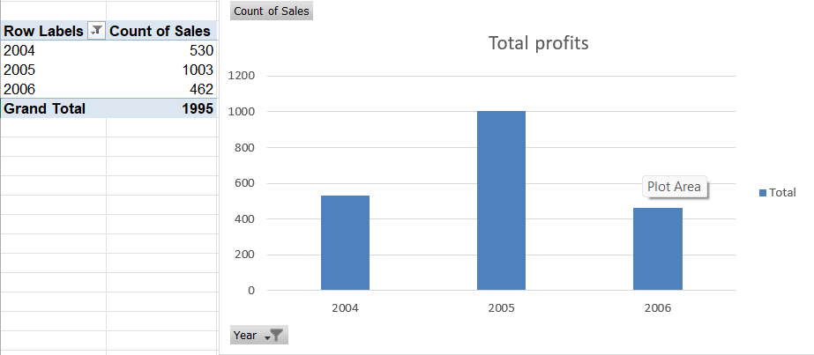
Total sales amount per year
Using the "Date" field, we extracted the year and summarized total sales annually. This helps understand business growth over time.

Slide 5
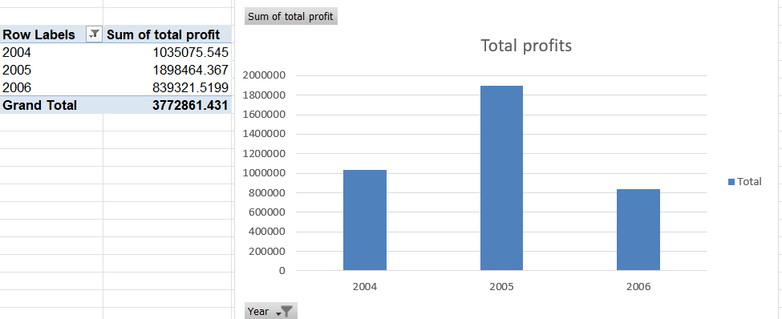
Total profits amount per year
Tracking annual profits helps evaluate financial success and operational efficiency year by year.

Slide 6
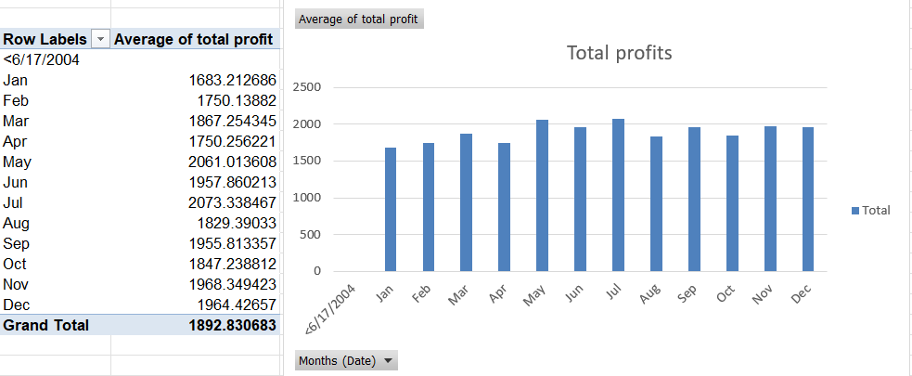
Average profits amount per month
We aggregated total profits by month and averaged them to identify seasonal profitability patterns.

Slide 7
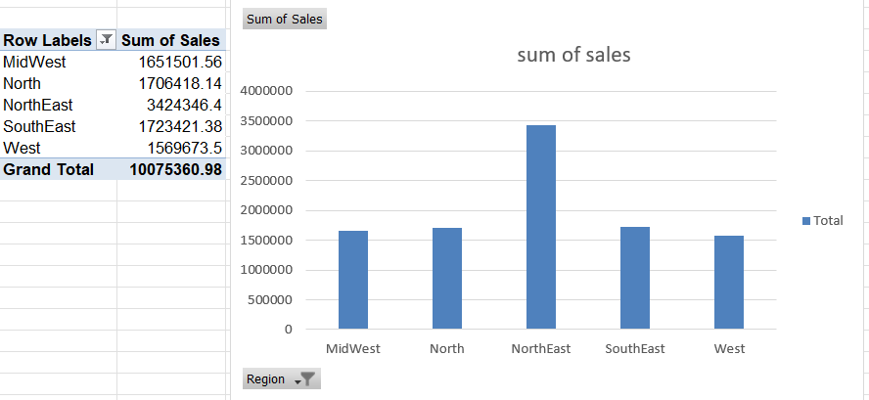
Sales amount per region
We aggregated total sales in each region to identify seasonal profitability patterns.

Slide 8

Sales Performance Analysis for region
Profit per Region per Year
To track the profitability trends of each region year by year.
Profit per Region per Quarter
To identify seasonal performance patterns at the regional level.

Slide 9
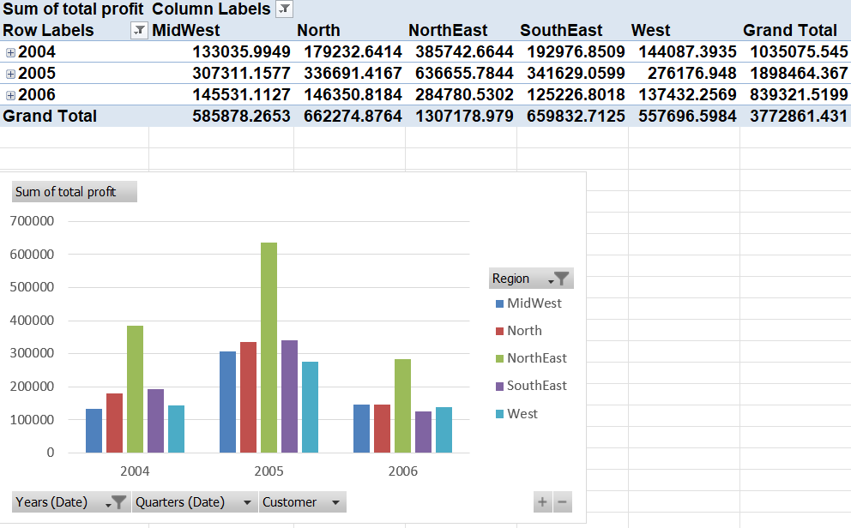
Profit per Region per Year
Purpose:
To track the profitability trends of each region year by year.
What it shows:
This table reveals how each region performed financially across different years. It helps identify growth trends, downturns, and regional consistency.

Slide 10
Profit per Region per Quarter
Purpose:
To identify seasonal performance patterns at the regional level.
What it shows:
By breaking down profit by quarter, we can observe whether some regions have seasonal strengths.

Slide 11


Sales Performance Analysis for Customer
Profit per Customer per Year
Profit per Customer per Region
To evaluate the value each customer brings yearly.
To evaluate customer value from a regional perspective.

Slide 12
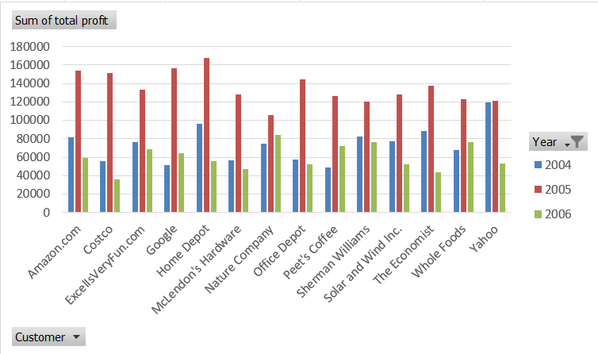
Profit per Customer per Year
Purpose:
To evaluate the value each customer brings yearly.
What it shows:
This report helps us understand which customers consistently contribute to profit and which may be declining or peaking in certain years.

Slide 13
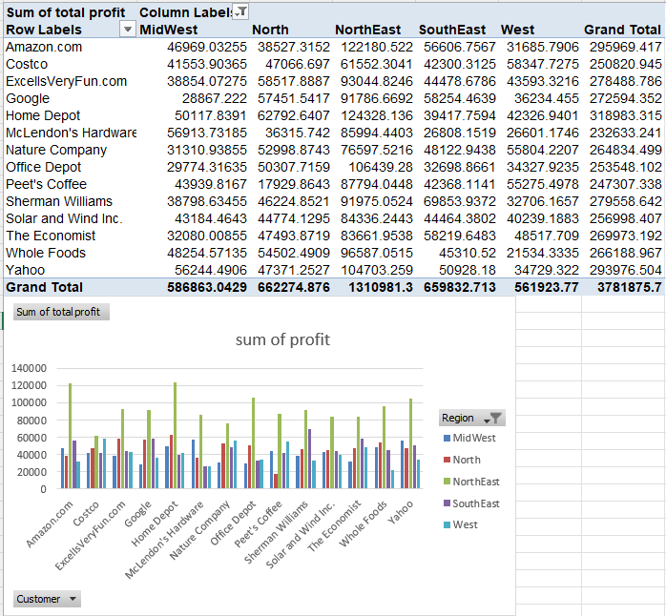
Profit per Customer per region
Purpose:
To evaluate customer value from a regional perspective.
What it shows:
Useful for identifying where each customer is most valuable, and whether they perform better in certain regions than others.

Slide 14
Sales Performance Analysis for sales rep
Profit per Sales Rep per Region
Profit vs COGS per Sales Rep
To compare profits with the cost of goods sold for each sales rep.
To assess the regional performance of each sales representative.

Slide 15
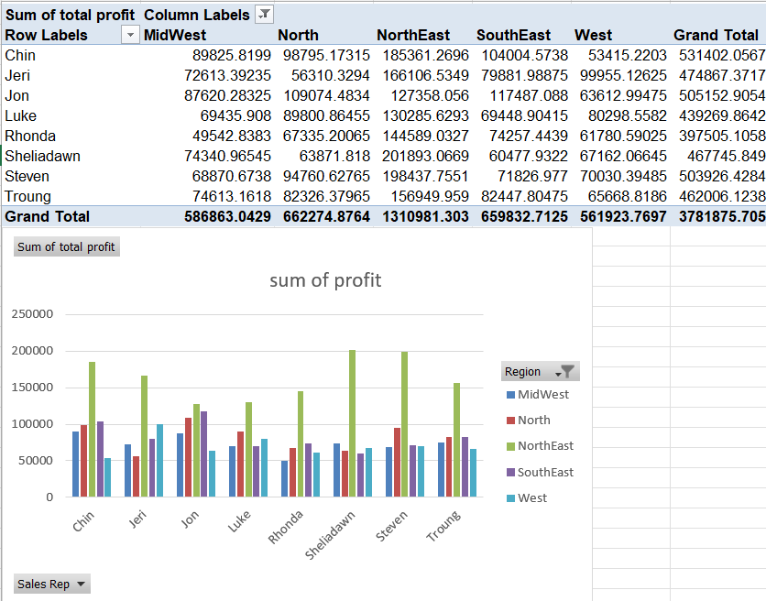
Profit per Sales Rep per Region
Purpose:
To assess the regional performance of each sales representative.
What it shows:
Helps compare how individual sales reps perform across different regions — valuable for managing teams and setting targets.

Slide 16
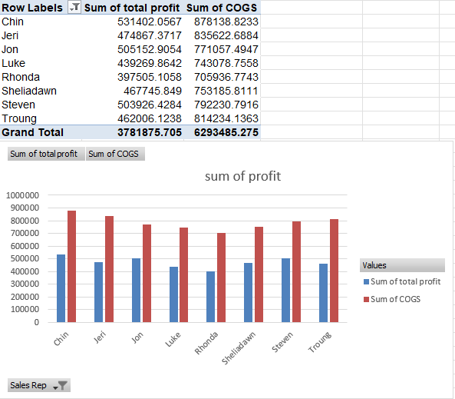
Profit vs COGS per Sales Rep
Purpose:
To compare profits with the cost of goods sold for each sales rep.
What it shows:
This analysis helps evaluate the efficiency of each sales rep – are they generating profit relative to their costs?

Slide 17
Conclusion
These 10 pivot views provide a multi-dimensional understanding of business performance:
Region-level trends over time
Seasonal shifts
High-value customers
Sales rep efficiency and cost impact
Together, they can support smarter strategic decisions in sales, customer targeting, and operations.

Slide 18
Thank you

